Slide 1
“It’s All About the Money” REAL WORLD Activity
Notes:
Greetings
Introduction
We are going to talk about Money……….your Money
What grades are here today? Show of hands ?
What are your plans after you graduate from high school – Start working?......Go to a vocational school?.......Go to a community college?......Go to a four year university?.......Other?
Show of hands - How many of you have thought, even once, for whatever reason, that you want to or are ready to be out on your own?
During our time together we hope to give you just a peek at what being on your own in the REAL WORLD might look like.
School, from elementary until now has been teaching you how to learn – helping you prepare for what is going to happen in a year or two – when you graduate!!!

Slide 2
Work
Homeownership
Credit
Rent
Taxes
Paycheck
Salary
DECISIONS
College
Budget
Bills
Family
Savings
New or Used Car
401(k)
Health Insurance
Interviews
New Job
Children
Notes:
School, from elementary until now has been teaching you how to learn – helping you prepare for what is going to happen in a year or two – when you graduate!!!
Then, many of you will be on your own and will have to start making……. (SLIDE)…….DECISIONS…..(slowly display other SLIDES) Decisions involving a wide variety of issues that will affect where you live, how you live and how much money you will have to live on.
Many of you will delay some of these decisions as you further your education.
These decisions will often affect you for a long time so you’ll need to get them right.
In order to get a better understanding of what some of these decisions will be and how you will make them, we are going to “transform” you into a 25 year old… Wage Earning …Bill Paying …Financially responsible young adult.
(SLIDE)

Slide 3
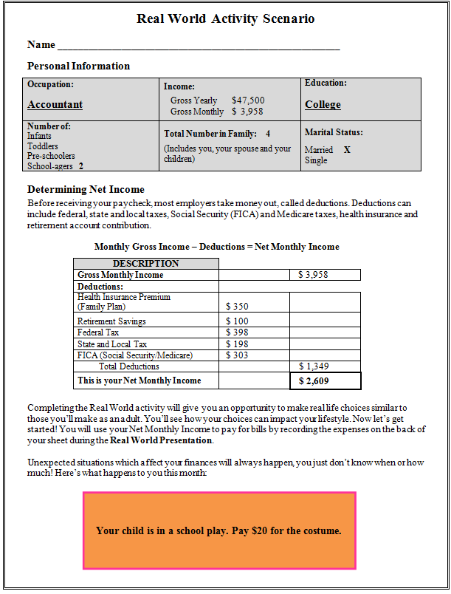
Notes:
Ask students to remove the Student Worksheet from their Student packets. Do they have something to write with? Say - for this activity the information on this worksheet is going to define the “new” you. There are 30 different profiles that were given out randomly in your student packets.
Some of you will be single / some married - Some will have children / some won’t - there are a variety of educational backgrounds which directly affect your job option which will have a big effect on your income.
EXPLAIN THE ACTIVITY – choose an option for several types of expenses and keep up with the balance on the back. (SLIDE)

Slide 4
Notes:
You can use a calculator. Also, please ask for help if you need it, but we are going to go through this pretty fast because that is how it is sometimes in the REAL WORLD
(SLIDE)

Slide 5
If you are married, ADD $1,000 for your spouse’s monthly paycheck
Notes:
If your worksheet says you are married turn it over and write in as a deposit $1,000 for your spouse’s income. Add that amount to your starting balance.
ASK - Everybody ready?
What is one of the largest expenses you will have when you are out on your own? Wait for responses…………………..(SLIDE)

Slide 6
Housing
Notes:
Ask – What are some of the issues you will need to consider when deciding on your choice of housing?
Wait for responses……………..(SLIDE)

Slide 7
How Much Can You Afford?
How Big Is Your Family?
Buy A House Or Rent An Apartment?
Notes:
Here is something for you to think about………..
Discuss the advantages and disadvantages for renting vs. owning a home.
Click for (SLIDES) after each question

Slide 8
Buy a House
Type | Payment | Tax/Insurance | Utilities | Total Expense
Older 2 bedrooms 1 bath, small lot | $555 | $155 | $190 | $900
New 3 bedrooms 2 baths, large lot | $1,000 | $300 | $250 | $1,550
Or Rent
Old Apartment 1 bedroom 1 bath | $625 | $25 | $150 | $800
3 Year Old Townhouse 3 bedrooms 2 baths | $850 | $35 | $215 | $1,100
Notes:
These are your options. Remember, your housing expense is not just a house payment or rent. You may have to pay property taxes and insurance and utilities – electricity / water / sewer/ cable.
REMIND THEM – a family of 4 can’t stay in a 1 bedroom apartment
Make your choice, write it on the back of the worksheet and subtract it from your balance.
Raise your hand if you have a question or need help.
WAIT……….(SLIDE)

Slide 9
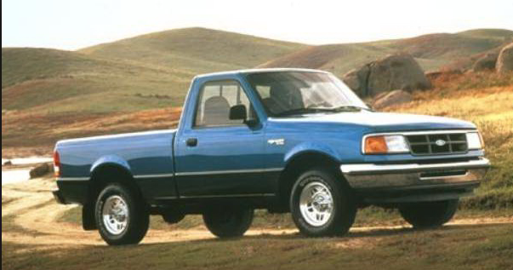
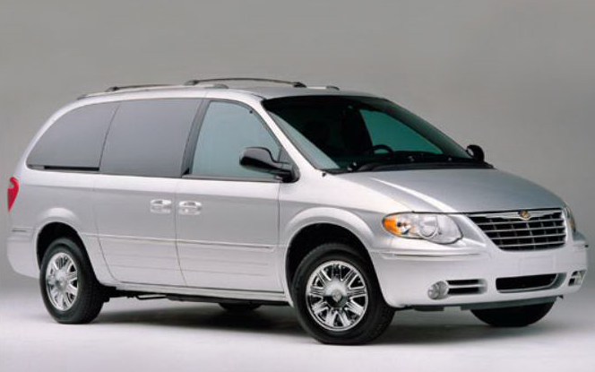
Transportation
Notes:
Now let’s move to another large expense. Here’s your chance to get a vehicle of your own. But remember, if you have a family of 4 – probably can’t go for the truck.
Do you buy a new or used vehicle?
How much can you afford?
(SLIDE)

Slide 10
Buy New
Type | Payment | Insurance | Gas | Total Expense
Small Truck | $425 | $55 | $70 | $550
Low Cost Compact Car | $325 | $40 | $60 | $425
Mini-Van | $450 | $30 | $85 | $565
Buy Used
Small Truck | $295 | $40 | $65 | $400
Low Cost Compact Car | $230 | $35 | $60 | $325
Mini-Van | $250 | $45 | $80 | $375
Notes:
These are your options. Your transportation expense includes a loan payment, insurance and gas, but doesn’t include any money for repairs and regular maintenance.
How you are going to pay for a repair if your car breaks down.
Make a choice, write the Total Expense on your worksheet and subtract it from your balance.
WAIT………(SLIDE)

Slide 11
Childcare
Notes:
Raise your hand if your profile includes children.
If you don’t have children look at the next slide to see how much children can cost.
(SLIDE)

Slide 12
Childcare
# of Children | Neighbor’s In-Home Daycare | Licensed “In Demand” Childcare
1 | $500 | $650
2 | $900 | $1,100
3 | $1,300 | $1,700
**Having your children stay with Grandma is not an option!**
Notes:
Neighbor’s In-Home Daycare means your children will pretty much watch TV all day while eating goldfish and apple juice. The In- Demand Childcare will teach your children and give them time to play outside.
If you have children, determine how many children you have, choose the type of facility you want to taking care of your children, write the corresponding expense on your worksheet and subtract it to get a new balance.
EMPHASIZE - Grandma loves her grandchildren to visit, but she said taking care of them every day is out of the question.
Wait……(SLIDE)

Slide 13
Groceries
Notes:
Everyone has different likes and dislikes when it comes to food. Some people are bargain hunters some do not keep a tight watch on what they spend. What type of shopper will you be?
We’ve made this one easy for you.
(SLIDE)

Slide 14
Groceries
Family Size( Parents & Children) | Add This Expense
Family of 1 | $300
Family of 2 | $400
Family of 3 | $500
Family of 4 | $600
Family of 5 | $700
**These figures do not include going out to eat!**
Notes:
Determine the total number in your family, write the corresponding expense on your worksheet and subtract to get their new balance.
If you like going out to eat – you’ll need to put more money aside because these prices are just for the grocery store.
Wait …….(SLIDE)

Slide 15
Cell Phone
Notes:
Is having a cell phone is a “NEED” or a “WANT”? ……response?
For the most part a cell phone is a NEED………..but the data plan is a WANT!!! You’ll need to sacrifice something to get the more expensive phone package.
How many of you pay for your cell phone plan now?.......response?
For those of you who don’t pay now, enjoy this time because in the REAL WORLD, you only get what you pay for!!!!!!!
(SLIDE)

Slide 16
Cell Phone
 | Individual | Married Plan
Pre-Paid Cell/No Contract | $40 | $60
Basic Pkg/No Data Plan | $60 | $85
Smart Phone w/Data Plan | $90 | $125
Notes:
Look at the options on the slide and pick the package you want. If you are married you must choose the expense in the married column.
Write down your choice and subtract it from your previous balance.
How are your funds holding out????
(SLIDE)

Slide 17
And then……….
The unexpected happens
Notes:
(At first there is a blank slide)
Say - There are lots of other expenses that you will have to include in your budget in the REAL WORLD – entertainment, clothes, credit card payments.
When you set up a budget be careful because, just when you think you have it all figured out……..(SLIDE – “And then….” SLIDE - The unexpected happens - Slide – the graphic wait a second - go to
(SLIDE to next page)

Slide 18
Look at the situation in the colored box on your worksheet. Add or subtract it from your balance.
Unexpected situations which affect your finances will always happen…you just don’t know when!
Notes:
Unexpected things can happen at any time. Some may be good things, but most are situations that require you to pay something you did not budget for. Where is that money coming from???????
Follow the instructions on the slide and add or subtract the situation from your previous balance. Raise your hand if you have questions.
(SLIDE)

Slide 19
Finally, the month is over. So, how did you do?
Who ran out of money?
Who still has money left?
Notes:
Who ran out of money?.....response. In the REAL WORLD there are two basic ways to fix this – either increase your income or decrease your expenses.
Increase income – 2nd job or go back to school to get additional training and education and look for a higher paying job
OR
Decrease expenses – look over the choices you made to see if you could have chosen a less expensive option.
In the REAL WORLD you can’t spend more than you make!!!!
Who had money left over?.....response. Any ideas on what you should do with it? Suggest savings.
Who can tell me about some of the expenses we didn’t cover? Some of the additional expenses not covered: eating out, movies, clothing, credit cards, internet, cable, life insurance, etc. When you get out on your own, you will have to make sure to budget for these items as well.
(SLIDE – goes to blank slide)

Slide 20
QUESTION………
Who will play the biggest part in preparing you for your financial future?
Notes:
(Starts with a blank screen)
If time - talk about the need for students to learn as much as they can about how to handle money. If they do not develop good strategies and learn what to do and what not to do, then someone else will control how they spend their money. Chances are that person will not have the best interest of the students in mind. So, the question is ………….. (SLIDE)……..responses

Slide 21
That would be YOU!!!!
Notes:
(SLIDE)
QUESTIONS??????
(SLIDE)

Slide 22
GOOD LUCK!!!

Slide 23
http://nccareers.org/
Complete the “Reality Check”
Then explore careers with the other apps that interest you where you would make enough money to cover your expenses!

