Slide 1
Future Fridays
NC Career and college Week–Free Apps on cfnc
FAFSA – Free Application for Federal Student aid
Scholarship opportunities
University Transfer pathway at Wake Tech
UGETC course options
Advanced Placement credits

Slide 2
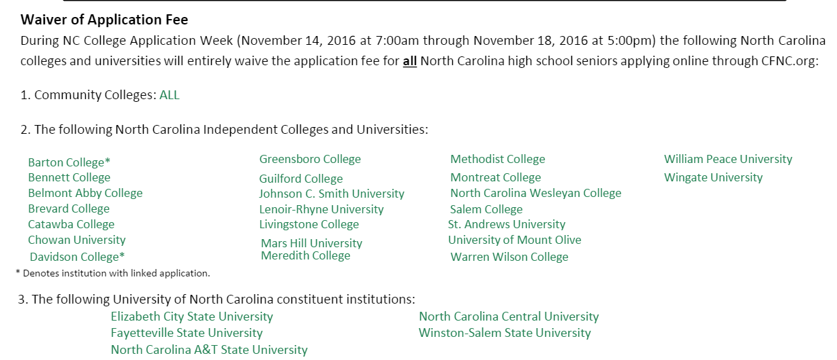
NC College Application Week

Slide 3
College Applications – Common App and CFNC
College Foundation of NC – CFNC.ORG
Create an Account - goo.gl/ooNuUC
Plan, Apply, Pay
Application Hub – Essentially every school in NC that don’t use the Common App

Slide 4
FAFSA
https://fafsa.ed.gov/
Application opens October 1st, 2016
Apply early, because when the money is gone, it’s gone
Use parents 2015 Tax info

Slide 5
Scholarship Opportunities
Apex High School Student Services:
http://apexhscounselors.weebly.com/scholarships.html
www.scholarshipplus.com/wake
www.finaid.org
www.collegeboard.com
www.cfnc.org

Slide 6
University Transfer pathway at Wake Tech
Wake Tech’s College/University Transfer programs are designed for students who wish to earn an associate’s degree and transfer to a four-year college or university to complete a bachelor’s degree. The programs offer general education courses as well as elective courses in areas of interest.
Wake Tech – Transfer Pathways - goo.gl/3lvc06

Slide 7
UGETC Course Options
UGETC Course List: https://goo.gl/wHRQdV
If you take any of these classes at a Community College in NC, you can transfer them to 4 year in state colleges with a C or higher in the class. These are great options to take over the summer in between your years in 4 year college.

Slide 8
Advanced Placement Credits
ECU - goo.gl/tkbFhO
NC State - goo.gl/eDDtSL
UNC Chapel-Hill - goo.gl/68s4v4
UNC Charlotte - goo.gl/JDHTrT
Wake Tech - goo.gl/9pneKX

