Slide 1
Dual Enrollment/CCP with Wake Tech – Q&A Night This presentation Download : tinyurl.com/QA1010WTCC
Jackson Hayes, CDC
jhayes2@wcpss.net
Room 1253

Slide 2
Relevant CCP Information
I've also created a Public Google Doc for all new and returning CCP students with FAQs, relevant forms, and a link for unofficial transcript requests. That can be found here:
https://tinyurl.com/ccpdoc19

Slide 3
Wake Tech’s CCP Site:
CCP.WAKETECH.EDU

Slide 4
After attending a mandatory Information Session, Forms that go to Wake Tech
Email these 3 things to ccp@waketech.edu
Signed EV Form
WTCC Application (Blue Form in Blue Folder)
Unofficial Transcript with 2.8 Unweighted GPA or higher
Students applying with 2.8 unweighted GPA or higher don’t need the test scores

Slide 5
Unofficial Transcript Request for Wake Tech Dual Enrollment
https://tinyurl.com/ahsrequest

Slide 6
EV Form

Slide 7
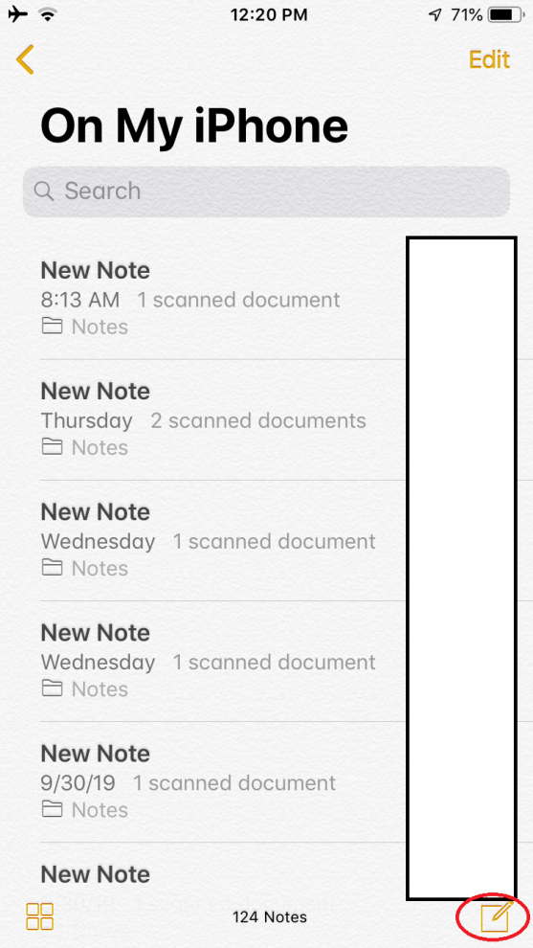
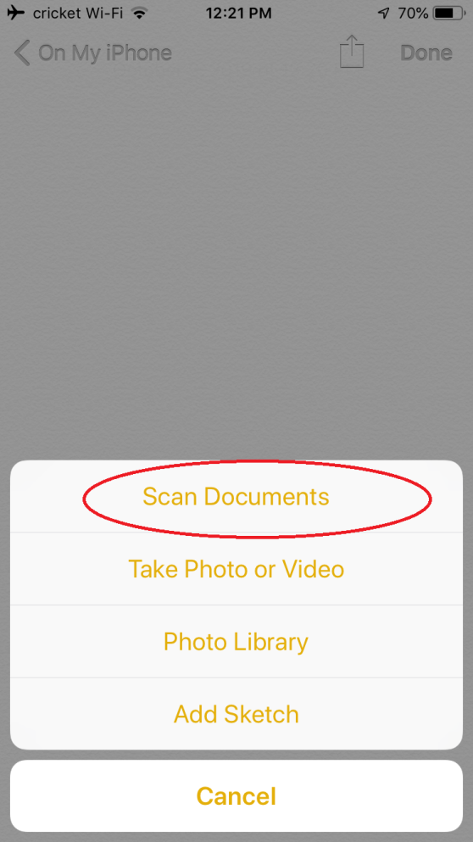
Scanning Your Documents with Notes App
Step 1
Step 2
Step 3

Slide 8
Forms that go to Apex High Counselor
Abbreviated Schedule Form
WCPSS Dual Enrollment Form

Slide 9
CTE Courses for CCP that count as 5.0 on High School Transcript – Count at 4 Year Colleges too
Business Administration: Business Core - Code - C25120DH
BUS 110
BUS 115
BUS 137
ECO 151
ACC 120
ACC 121 – Accounting and Finance – C25800CH
Criminal Justice • Code - C55180B
CJC-111
CJC-121
iOS Application Developer -CIS 115
Info Tech – Computer Tech - CTS 115
CSC-120 Computing Fundamentals I

Slide 10
CTE Articulation
There are several courses at Apex High School that count as community college credits.
We will automatically do all of the paperwork to get these credits added to Wake Tech transcripts for CCP students!
Articulation – A 90 or higher on the Exam in a CTE class could get College Credit*.List: tinyurl.com/articulate2018

Slide 11
Relevant CCP Information
I've also created a Public Google Doc for all new and returning CCP students with FAQs, relevant forms, and a link for unofficial transcript requests. That can be found here:
https://tinyurl.com/ccpdoc19

Slide 12
Dual Enrollment/CCP with Wake Tech – Q&A Night This presentation Download : tinyurl.com/QA1010WTCC
Jackson Hayes, CDC
jhayes2@wcpss.net
Room 1253

