Slide 1
Business Math in Culinary
Recipes and Food Costs
Existing Yield, Desired Yield, and Conversion Factor
Recipe Calculator
Measurements and Equivalents
Link for PowerPoint: https://tinyurl.com/culinarymath1
Recipe Calculator: https://tinyurl.com/apexrecripecalc

Slide 2
Purchasing from Lowes Food
Recipe – Grilled Cheese Sandwich
Bread
Cheese
Butter
10 Slices
Price: $2.99
Tax: $.06
Total: $3.05
Lowes Salted Butter, 16 oz
Price: $3.29
Tax: $.07
Total: $3.36
12 slices
Price: $3.50
Tax: $.07
Total: $3.57

Slide 3
How much should we charge for our grilled cheese sandwich?

Slide 4
How much does it cost to make 1 Grilled Cheese Sandwich?

Slide 5
Purchasing from Lowes Food
Recipe – Grilled Cheese Sandwich
Bread
Cheese
Butter
10 Slices
Price: $2.99
Tax: $.06
Total: $3.05
Lowes Salted Butter, 16 oz
Price: $3.29
Tax: $.07
Total: $3.36
12 slices
Price: $3.50
Tax: $.07
Total: $3.57

Slide 6
How much does it cost to make 1 Grilled Cheese Sandwich?
Basic Recipe
Bread = 2 slices
Cheese = 2 slices
Butter = 0.5 oz

Slide 7
How much does it cost to make 1 Grilled Cheese Sandwich?
Basic Recipe
Bread = 2 slices
Cheese = 2 slices
Butter = 0.5 oz
Percentage of Amount Ordered
2 slices/12 slices =
2 slices/10 slices =
0.5 oz/16 oz =

Slide 8
How much does it cost to make 1 Grilled Cheese Sandwich?
Basic Recipe
Bread = 2 slices
Cheese = 2 slices
Butter = .5 oz
Percentage of Amount Ordered
2 slices/12 slices = 0.166666
2 slices/10 slices = 0.20
0.5 oz/16 oz = 0.03125

Slide 9
How much does it cost to make 1 Grilled Cheese Sandwich?
Basic Recipe
Bread = 2 slices
Cheese = 2 slices
Butter = .5 oz
Percentage of Amount Ordered
2 slices/12 slices = 0.166666
2 slices/10 slices = 0.20
0.5 oz/16 oz = 0.03125
Basic Recipe
Bread = 2 slices
Cheese = 2 slices
Butter = .5 oz
Unit Cost/Ingredient
0.166 X $3.57 =
0.20 X $3.05 =
0.03125 X $3.36 =

Slide 10
How much does it cost to make 1 Grilled Cheese Sandwich?
Basic Recipe
Bread = 2 slices
Cheese = 2 slices
Butter = .5 oz
Percentage of Amount Ordered
2 slices/12 slices = 0.166666
2 slices/10 slices = 0.20
0.5 oz/16 oz = 0.03125
Basic Recipe
Bread = 2 slices
Cheese = 2 slices
Butter = .5 oz
Unit Cost/Ingredient
0.166 X $3.57 = $0.59
0.20 X $3.05 = $0.61
0.03125 X $3.36 = $0.11

Slide 11
How much does it cost to make 1 Grilled Cheese Sandwich?
Unit Cost/Ingredient
0.166 X $3.57 = $0.59
0.20 X $3.05 = $0.61
0.03125 X $3.36 = $0.11
Total: $1.31

Slide 12
How much should we charge for our grilled cheese sandwich?

Slide 13
How much should we charge for our grilled cheese sandwich?
Our Goal is a food cost of no more than 50%
Unit Cost/Ingredient
0.166 X $3.57 = $0.59
0.20 X $3.05 = $0.61
0.03125 X $3.36 = $0.11
Total: $1.31

Slide 14
How much should we charge for our grilled cheese sandwich?
Our Goal is a food cost of no more than 50%
Unit Cost/Ingredient
0.166 X $3.57 = $0.59
0.20 X $3.05 = $0.61
0.03125 X $3.36 = $0.11
Total: $1.31
$1.31 X 2 = $2.62
We need to sell these for at least $2.62/sandwich to hit our goal

Slide 15
Existing Yield, Desired Yield, and Conversion Factor
Existing Yield – This is the number of servings that the recipe currently makes
Desired Yield – The actual number of servings we need to create
Conversion Factor – Desired Yield Divided by Existing Yield
Equation
(Conversion Factor) = (Desired Yield)/(Existing Yield)

Slide 16
Existing Yield, Desired Yield, and Conversion Factor
Conversion Factor – Desired Yield Divided by Existing Yield
(Conversion Factor) = (Desired Yield)/(Existing Yield)
Example. – My Grilled cheese recipe makes 1 serving (Existing Yield), if I need to make 15 sandwiches (Desired Yield), then what is the conversion factor?

Slide 17
Existing Yield, Desired Yield, and Conversion Factor
Conversion Factor – Desired Yield Divided by Existing Yield
(Conversion Factor) = (Desired Yield)/(Existing Yield)
Ex. – My Grilled cheese recipe makes 1 serving (Existing Yield), if I need to make 15 sandwiches (Desired Yield), then the conversion factor is:
15 is the conversion factor
We need 15 times the ingredients for 15 servings in this situation

Slide 18
Existing Yield, Desired Yield, and Conversion Factor
Conversion Factor – Desired Yield Divided by Existing Yield
(Conversion Factor) = (Desired Yield)/(Existing Yield)
Conversely, if I have a cookie recipe that makes 100 cookies, and I only need 50 cookies
What is the Conversion Factor?

Slide 19
Existing Yield, Desired Yield, and Conversion Factor
Conversion Factor – Desired Yield Divided by Existing Yield
(Conversion Factor) = (Desired Yield)/(Existing Yield)
Conversely, if I have a cookie recipe that makes 100 cookies, and I only need 50 cookies,
What is the Conversion Factor?
Then 50 cookies (Desired Yield / 100 cookies (Existing Yield) = 0.50 (Conversion Factor)
This means you need half the ingredients

Slide 20
Recipe Calculator
https://tinyurl.com/apexrecripecalc
Type in this link above
Click “File” and “Make a Copy”
Save a copy in your google drive and name it accordingly
The Yellow cells represent the places that require your entry

Slide 21
Measurements and Equivalents
Available via quick google searches as well. I’ve also built a chart on the recipe calculator. It’s important that the unit of measurements are relative to each other to calculate unit cost.

Slide 22
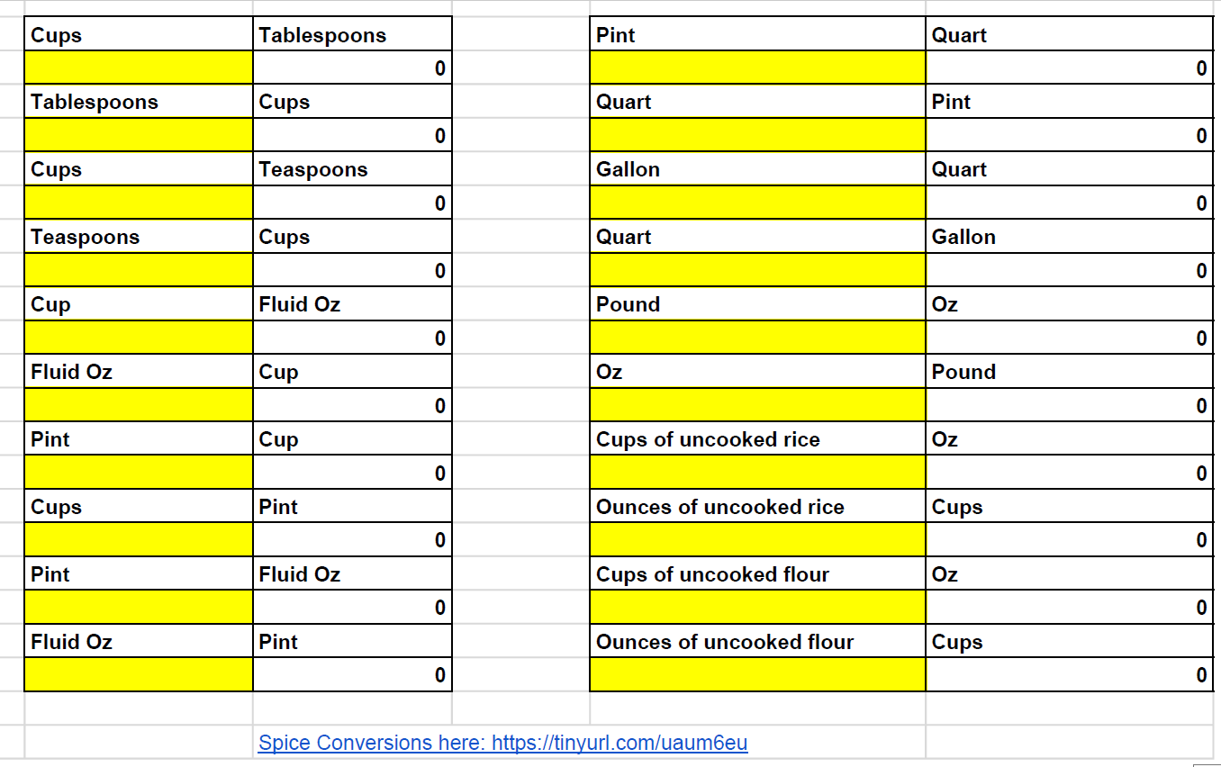
Conversion Rates
https://tinyurl.com/apexrecripecalc
Scroll Down on the Recipe Calculator to find conversions for measurements
Your measurement units need to match for the calculator to work correctly

Slide 23
Your assignment
Craft the ultimate grilled cheese sandwich recipe using:
Lowes Food Online Shopping for ingredients and prices – you pick the type of bread,
Input your ingredients, prices, and amounts per serving (in equivalent units) in to the Recipe Calculator. We should be able to see the unit cost per ingredient and Existing Yield.
https://tinyurl.com/apexrecripecalc
Project out required ingredients to serve 30 people (Desired Yield) using the “recipe calculator)
Share the completed Google Sheet with jhayes2@wcpss.net

Slide 24
Business Math in Culinary
Recipes and Food Costs
Existing Yield, Desired Yield, and Conversion Factor
Recipe Calculator
Measurements and Equivalents
Link for PowerPoint: https://tinyurl.com/culinarymath1
Recipe Calculator: https://tinyurl.com/apexrecripecalc

